Slide 1
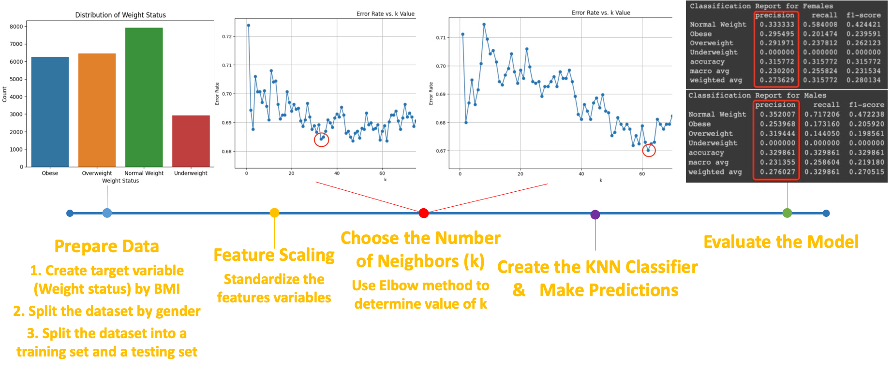

Slide 2
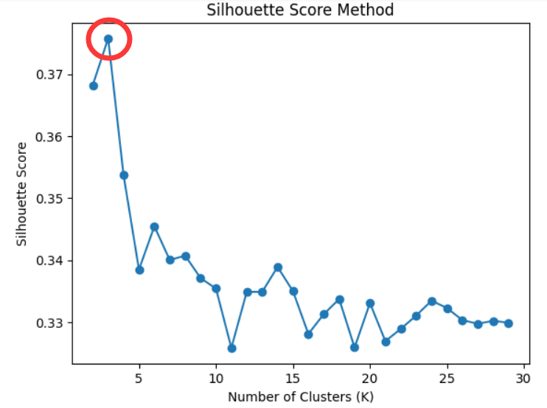
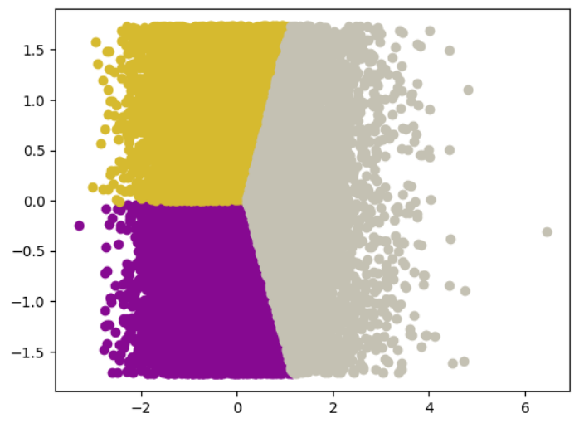
Cluster 1
BMI = 23.2 (4.7)
Calories = 3,027 (288)
Cluster 2
BMI = 35.0 (4.6)
Calories = 2,511 (492)
Cluster 0
BMI = 23.3 (4.7)
Calories = 1,965 (284)
Prepare the data:
1. Select features: BMI and daily caloric intake
2. Sex-stratify
Feature scaling
Standardize BMI and calories
Choose K
1. Silhouette score method
2. K = 3 for whole and male/female samples
Perform K means analysis to assign data to 3 clusters
Visualize results
0: Low BMI, low calorie
1: Low BMI, high calorie
2: High BMI, variable calorie
Describe clusters
Descriptive statistics

Slide 3
Conclusion on Key Findings
Overall accuracy for general KNN model: 32%
After stratifying by gender, the KNN model on female vs male has an accuracy: 32% vs 33%
No obvious difference between the performance of KNN models among different gender groups; but the KNN model on female group performs slightly better than male group on predicting obese and overweight groups, and slightly worse than male group on predicting the normal weight group.
K-Means clustering based on features BMI and Calorie Intake revealed 3 clusters, with minimal sex differences.
Limitations
The accuracy for predicting underweight group is 0 because they are underrepresented under large k.
The overall accuracy is lower than expected.

